Slide 1
Glaucoma Detection Using Convolutional Neural Networks
Project Guide : Team members :
Mr. S.A.K. JAINULABUDEEN, M. TECH, Nishant Bhushan C [ 211417104168 ]
supervisor, Nitheesh Kumar P [ 211417104171 ]
Assistant Professor. Kumaran R [ 211417104125 ]

Slide 2
Abstract
Glaucoma is a chronic and irreversible eye disease, which leads to deterioration in vision and quality of life.
Deep learning systems, such as convolutional neural networks (CNNs), can infer a hierarchical representation of images to discriminate between glaucoma and non-glaucoma patterns for diagnostic decisions.
The model is trained with the DRISHTI-GS1 dataset using deep learning API keras over Tensorflow. The Network architecture used gives great accuracy.

Slide 3
Introduction
Glaucoma is one of the most hazardous ocular diseases. It is a set of disorders, categorized mostly by high intraocular pressure (IOP) causing damage to the optic nerve.
According to the World Health Organization it is second foremost cause of blindness worldwide. Glaucoma is also known as snitch thief of sight because resembling a hushed slayer it usually has no indicators till permanent vision loss occurs
Glaucoma is often linked to a build-up of pressure inside the eyes. Glaucoma tends to ruin families and one usually doesn’t get it until later in life.

Slide 4
Literature Survey
TITLE | AUTHORS | DESCRIPTION
Detection of Glaucoma Using Retinal Fundus Images(IEEE 2014) . | Hafsah Ahmad, Abubakar Yamin, Aqsa Shakeel, Syed Omer Gillani, Umar Ansari | This paper proposes an image processing technique for the detection of glaucoma which mainly affects the optic disc by increasing the cup size
Automatic Glaucoma Detection by Using Funduscopic Images(IEEE 2016). | Atheesan S., Yashothara S | In this paper, we have proposed a Convolutional Neural Network (CNN) system for early detection of Glaucoma.
Automated Detection of Suspected Glaucoma in Digital Fundus Images(IEEE 2017) | Namita Sengar, Malay Kishore Dutta, Radim Burget, Martin Ranjoha | The increased cup to disc ratio (CDR) results in the loss of optic nerve fibres that are connected to the retina by disc area.

Slide 5
Problem Statement
The majority of persons with glaucoma do not experience any early signs or pain. It is impossible to restore a person's vision once it has been lost.
Traditional methods of detecting glaucoma include an eye doctor analyzing the images and finding the abnormalities in it.
This process is very time consuming and not always accurate because the image contains noise and other factors which make it difficult for proper analysis.
It has many disadvantages like This method works with graph-based methods that are not easily extended to multi-label task.

Slide 6
Technology Stack
Front End:
Back End:
Specifications:
Html 5, Css3, Javascript.
Tools Used :
Visual Studio Code.
Technology:
Deep learning, CNN
python → tensor flow
Teachable interface
Dristhi-GS1 dataset.
101 images, size-2047*1760
Kaggle fund images
1000 images
Algorithm :
Keras → VGG19
Hardware Specifications:
processor : Intel Pentium Dual Core 2.00GHz
Hard Disk : 500 GB
RAM : 8 GB
Software Specifications:
Python 3.4.6

Slide 7
System Architecture
Input Image
Filtering
Pre-processing
Normalization
Glaucoma Input Image
Patch Extraction
Feature Extraction
Test feature
Train feature
CNN Classification
Labels
Glaucoma Specificity
Estimation
Glaucoma Accuracy
Sensitivity

Slide 8
System Design : Work Flow Chart
DRISHTI GS1 dataset images
Kaggle fund images
Image classification
Pre-processing image
Training model using Teachable Interface
Hardware Interaction
Prediction using Keras and TensorFlow
Output using User Interface

Slide 9
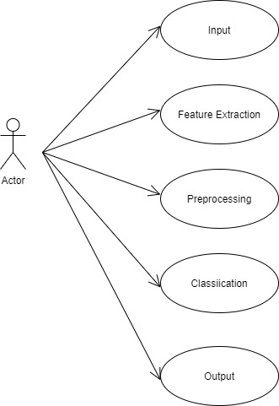
UseCase Diagram

Slide 10
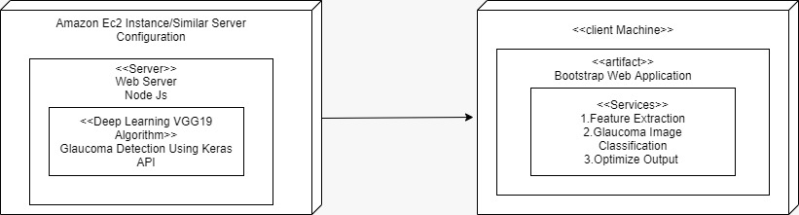
Deployment Diagram

Slide 11
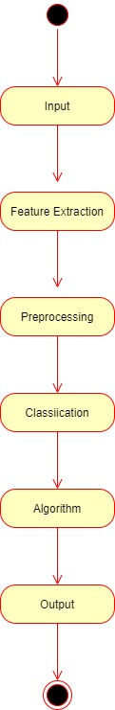
Activity Diagram

Slide 12
Proposed Solution
This traditional method can be surpassed by a system that employs a novel semi-automatic detection method based on CNN deep Learning Techniques.
As there are numerous computer-based techniques available to detect Glaucoma disease.
The goal of the proposed system uses VGG19 algorithm is to improve the performance and accuracy of the existing system by utilizing the Deep Learning Keras API.

Slide 13
WORKING OF THE PROPOSED SYSTEM
The pre-processed image is given as an input to the CNN model which consists of an input layer, convolution layers and a fully connected layer.
The input image of 256x256pixel acts as the input layer. In the first convolution layer, 16 filters of 3x3 size kernels each are applied to the input image by gliding one by one through the position and a total of 16 feature maps are generated.
These features are then applied to the ReLU activation function, which performs a threshold operation for each input variable with values below zero.
The output of the last convolution layer acts as an input for the next convolution layer.

Slide 14
Continued..
The next convolution layer contains of 32 3x3 scale kernel filters that are applied to each of function maps retrieved from the last layer.
Specific operations like ReLU and max pooling are carried out to generate 64x64 pixel down-sampled data.
The same operations are performed on the third layer which is the last layer where 64 filters of 3x3 size kernels are used which produce 32x32 pixel data. The third convolution layer has an output of 64 32x32 pixel feature maps.
These features are then leveled to a single 32x32x64 = 65536 long vector, that acts as an input to a fully-connected layer.
These features are then used to evaluate the image type whether it is an healthy eye or glaucoma- infected eye.

Slide 15
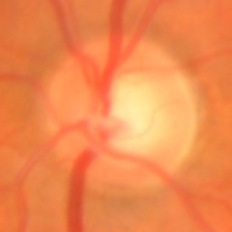
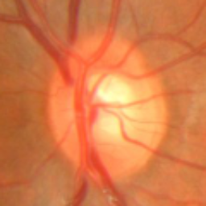
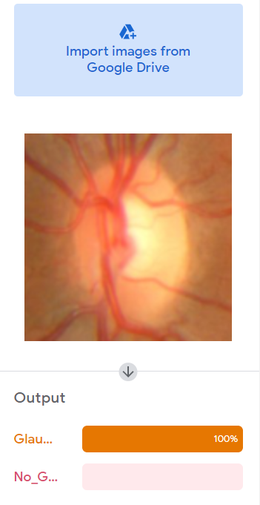
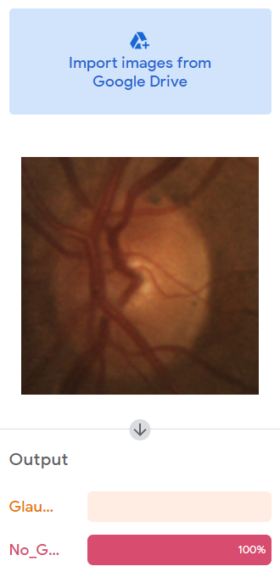
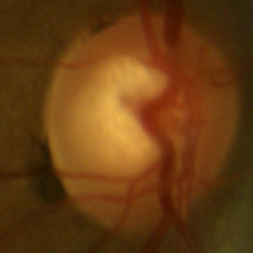
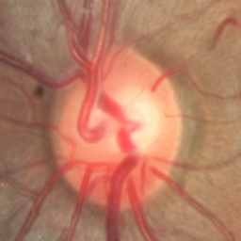
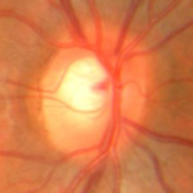
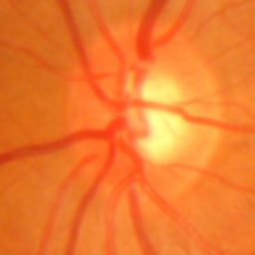
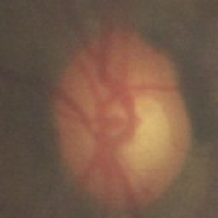
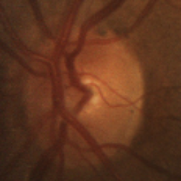
Images
With Glaucoma
Without Glaucoma

Slide 16
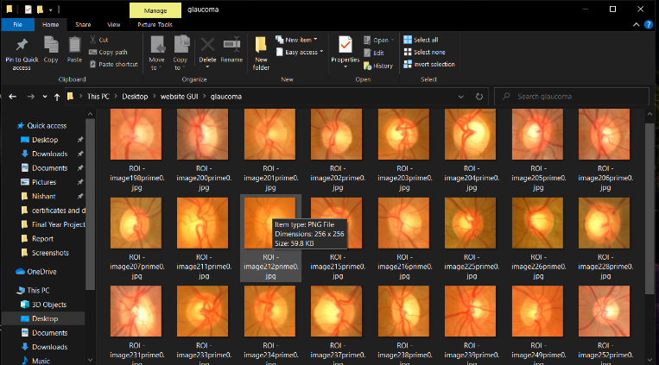
Dataset without glaucoma

Slide 17
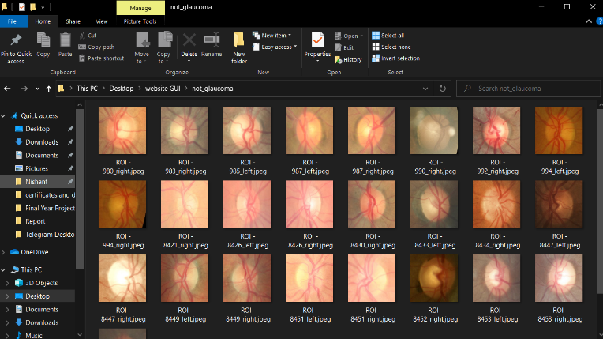
Dataset with glaucoma

Slide 18
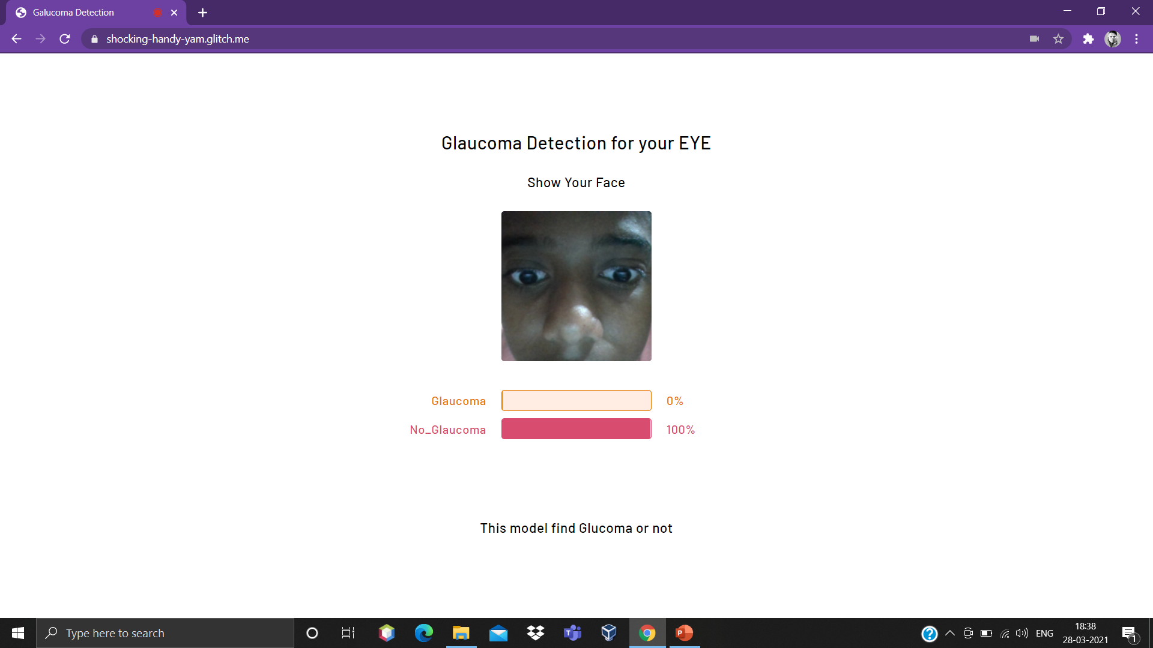
OUTPUT

Slide 19
Testing
Action | Expected Result | Actual Result | Status
Accessing the webcam | The UI request the OS to access webcam | The UI request the OS to access webcam | pass
PERSON WITH GLAUCOMA problem | The UI glaucoma progress bar should increase | The UI glaucoma progress bar increases | pass
Person without glaucoma problem | The UI without glaucoma progress bar should increase | The UI without glaucoma progress bar increases | pass

Slide 20
Future Enhancement And Conclusion
Glaucoma is a “silent thief of sight” having no early symptoms and can cause permanent blindness if not detected or diagnosed at an early stage.
Fundoscopy enables ophthalmologists to analyze the internal retinal structural changes i.e. change in CDR, ISNT ratio.
Proposed methodology provides an algorithm to detect glaucoma by analyzing the structural changes from fundus image and correlate the results with classification results from deep learning module.
Proposed system is able to screen out glaucoma patients 100 % accuracy as none of the glaucoma case is classified as normal.
Proposed system can enhance evaluvation by adding additional datasets .

Slide 21
References
[1]“Detection of Glaucoma Using Retinal Fundus Images” Hafsah Ahmad, Abubakar Yamin, Aqsa Shakeel, Syed Omer Gillani, Umer Ansari(IEEE 2014).
[2]“Automatic Glaucoma Detection by Using Funduscopic Images”, Atheesan S., Yashothara S.(IEEE 2016).
[3]”Automated Detection of Suspected Glaucoma in Digital Fundus Images”, Namita Sengar, Malay Kishore Dutta, Radim Burget, Martin Ranjoha(IEEE 2017) .
[4] Budai A, Bock R, Maier A, Hornegger J, Michelson G. Robust vessel segmentation in fundus images. Int J Biomed Imag. 2013.

Slide 22
Continued..
[5]Simonyan K, Zisserman A. Very deep convolutional networks for largescale image recognition. 2014. ArXiv e-prints arxiv:abs/1409.1556.
[6]Carneiro G, NascimentoJ, Bradley AP. In : Navab N, Hornegger J, Wells WM, Frangi AF, eds. Unregistered multiview mammogram analysis with pretrained deep learning models.
[7]World Health Organization. Bulletin of the World Health Organization, Volume 82(11). 2004.
[8] Bourne RRA. Worldwide glaucoma through the looking glass. Br J Ophthalmol.2006.
[9]Bock R, Meier J, Nyúl LG, Hornegger J, Michelson G. Glaucoma risk index: automated glaucoma detection from color fundus images. Med Image Anal. 2010

Slide 23
Journal Details
Title of the paper : “Glaucoma Detection Using Convolutional Neural Networks”
Journal Name : “ International Journal for Science and Advance Research In
Technology”
Paper ID : IJSARTV71648859
Published In : Volume : 7 , Issue : 6
Publication Date : 8 June 2021.

Slide 24
Thank You

